Slide 1
Installation Guide
(Eclipse Plug-in － JUtils 3.1)
2008. 12. 16
CODELABOR
Shin Sang Jae (codelabor@gmail.com)

Slide 2
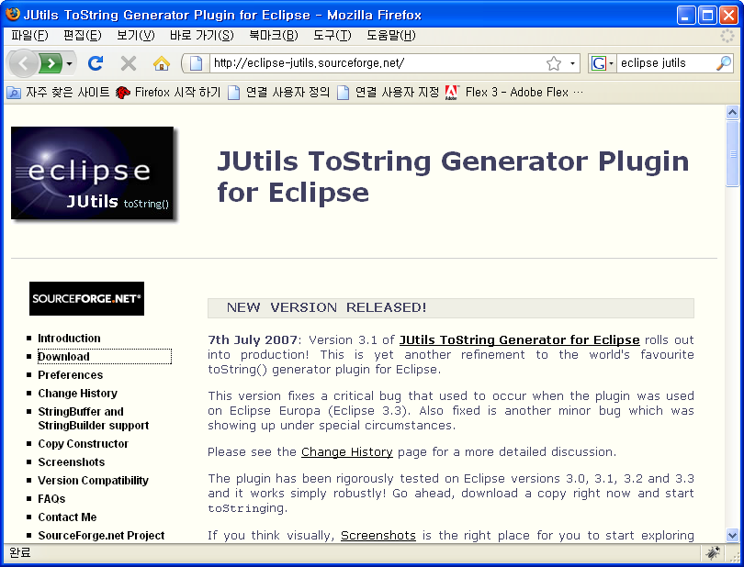
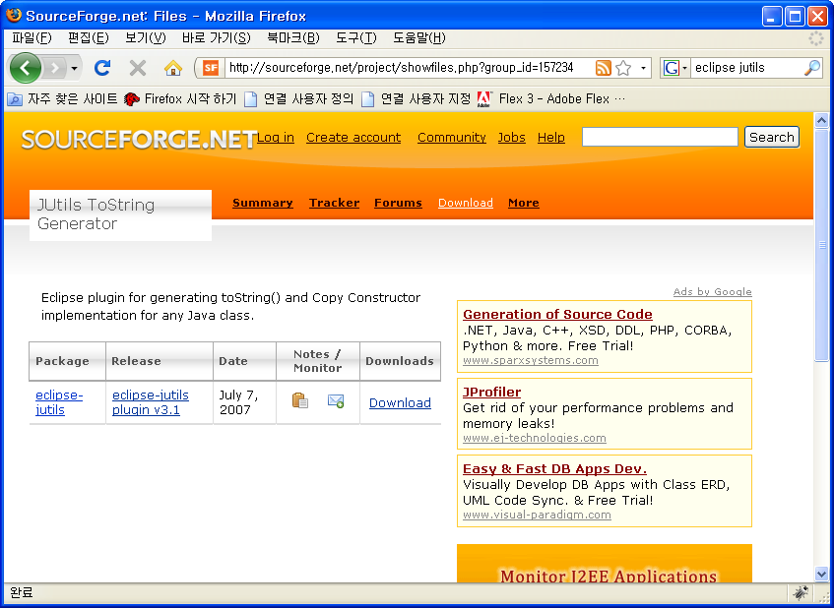
JUtils
Download
Eclipse toString() generator plug-in
Official Site URL: http://eclipse-jutils.sourceforge.net/
Download Site URL: http://sourceforge.net/project/showfiles.php?group_id=157234
Eclipse update site URL: N/A

Slide 3


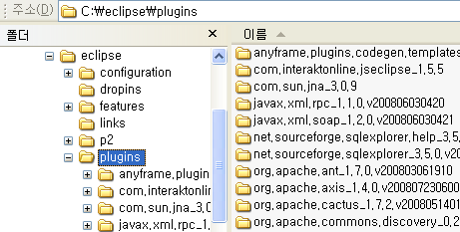
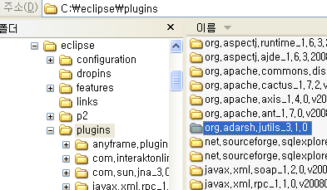
JUtils
Install
Download File: org.adarsh.jutils_3.1.0.zip
Unzip
Copy into Eclipse plugin directory

Slide 4
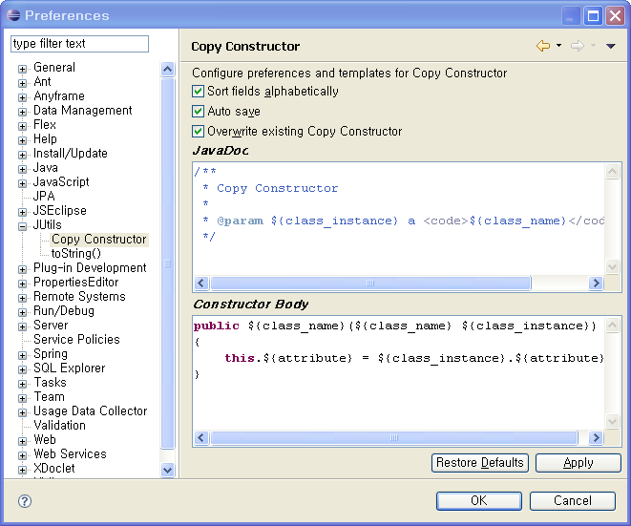
JUtils
Configuration
Windows > Preferences
Check sort fields alphabetically
Check auto save

Slide 5
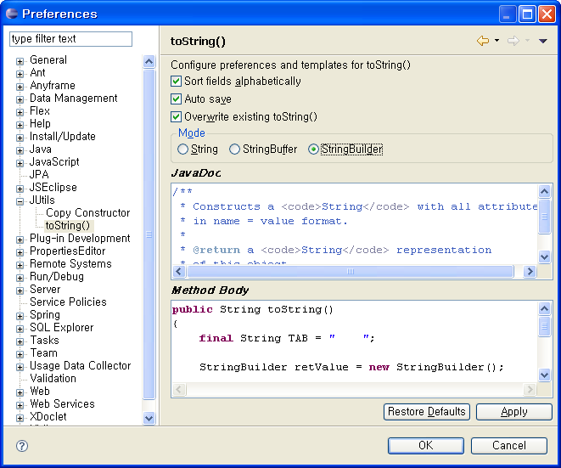
JUtils
Configuration
Windows > Preferences
Check sort fields alphabetically
Check auto save
Select StringBuilder

